Slide 1
Processes and Threads
Chapter 2
2.1 Processes
2.2 Threads
2.3 Interprocess communication
2.4 Classical IPC problems
2.5 Scheduling

Slide 2
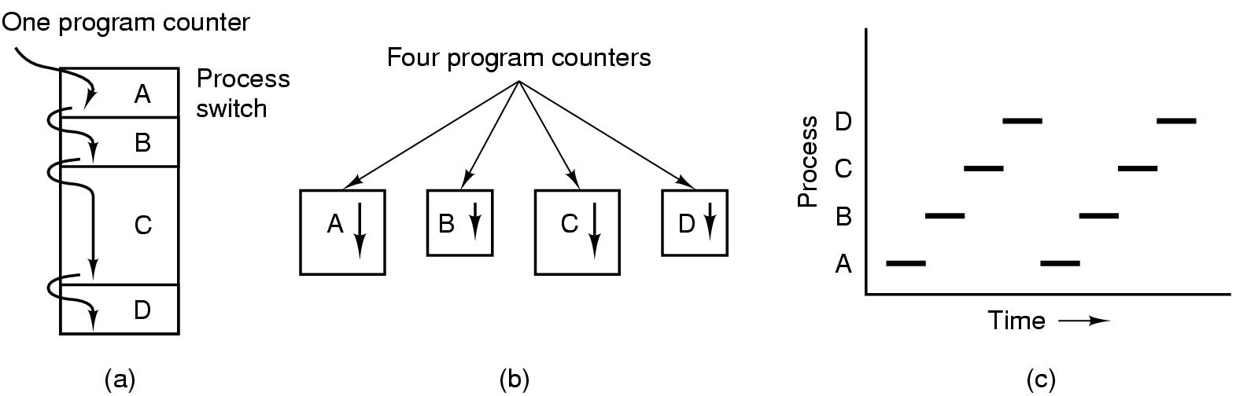
Processes The Process Model
Multiprogramming of four programs
Conceptual model of 4 independent, sequential processes
Only one program active at any instant

Slide 3
Processes The Process Model
מקבליות מדומה – החלפה מהירה בין תהליכים, יש תקורה overhead
החלפה == context switch, לא ניתן לעשות הנחות על זמן, התהליך לא מודע להשהייתו
-----
מקבליות אמיתית – i/o כאשר תהליכים ממתינים לIO ניתן להריץ אחרים
IO
IO
Q קטן משפר מקבליות מדומה,
Q גדול משפר ניצולת מעבד
Multiprogramming of four programs
Conceptual model of 4 independent, sequential processes
Only one program active at any instant
i++
Getch()
CSW
CSW

Slide 4
Process Creation
Principal events that cause process creation
System initialization
Execution of a process creation system
User request to create a new process
Initiation of a batch job

Slide 5
Process Termination
Conditions which terminate processes
Normal exit (voluntary)
Error exit (voluntary)
Fatal error (involuntary)
Killed by another process (involuntary)

Slide 6
Process Hierarchies
Parent creates a child process, child processes can create its own process
Forms a hierarchy
UNIX calls this a "process group"
Windows has no concept of process hierarchy
all processes are created equal

Slide 7
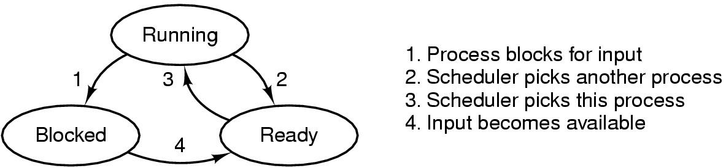
Process States (1)
נגמר ה quantom
IO
אמיתי
מקבל תזמון
מדומה
ממתין לIO
אירוע הגיע ומ"ה טיפלה בו
Possible process states
running
blocked
ready
Transitions between states shown

Slide 8
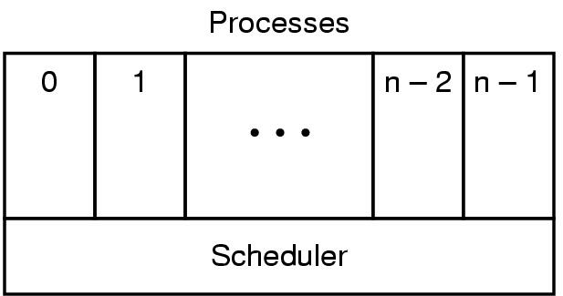
Process States (2)
Lowest layer of process-structured OS
handles interrupts, scheduling
Above that layer are sequential processes

Slide 9
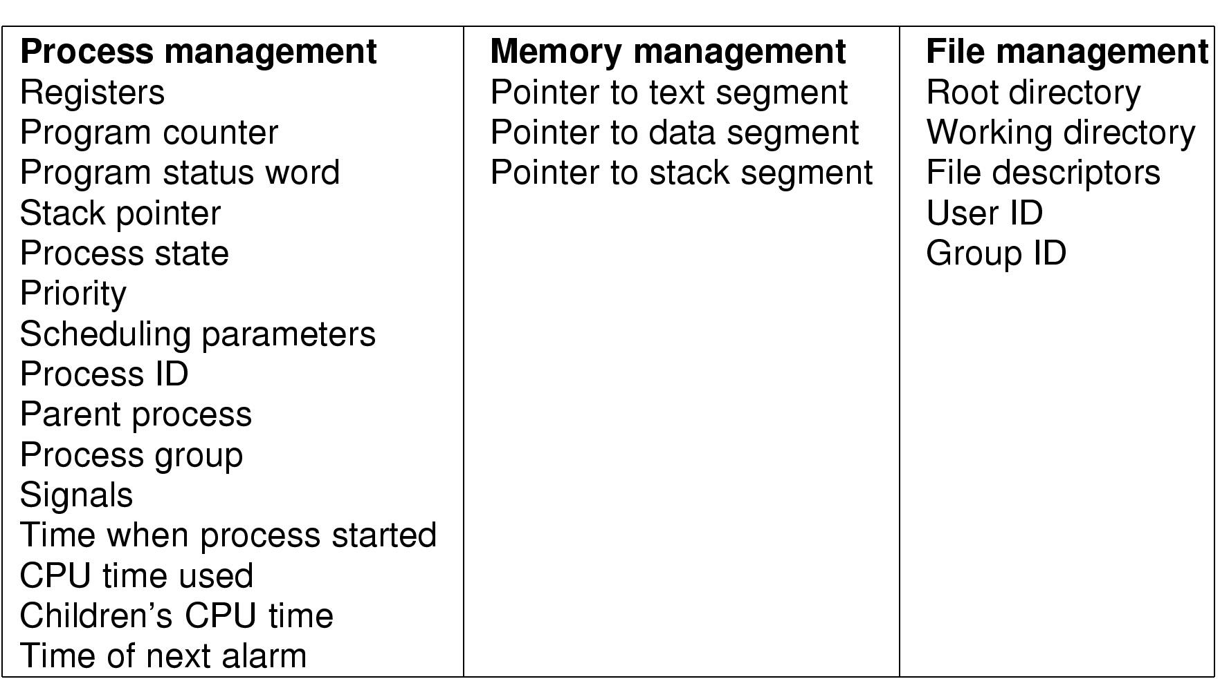
Implementation of Processes (1)
Some Fields of a process table entry

Slide 10
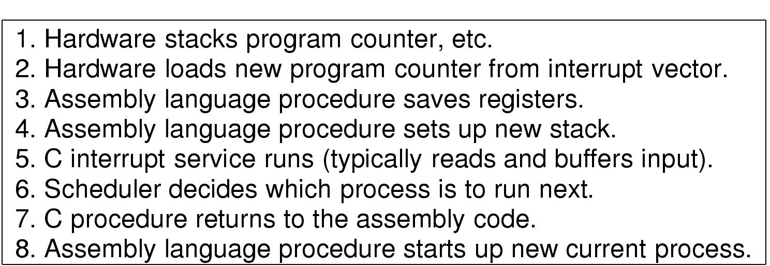
Implementation of Processes (2)
Skeleton of what lowest level of OS does when an interrupt occurs

Slide 11
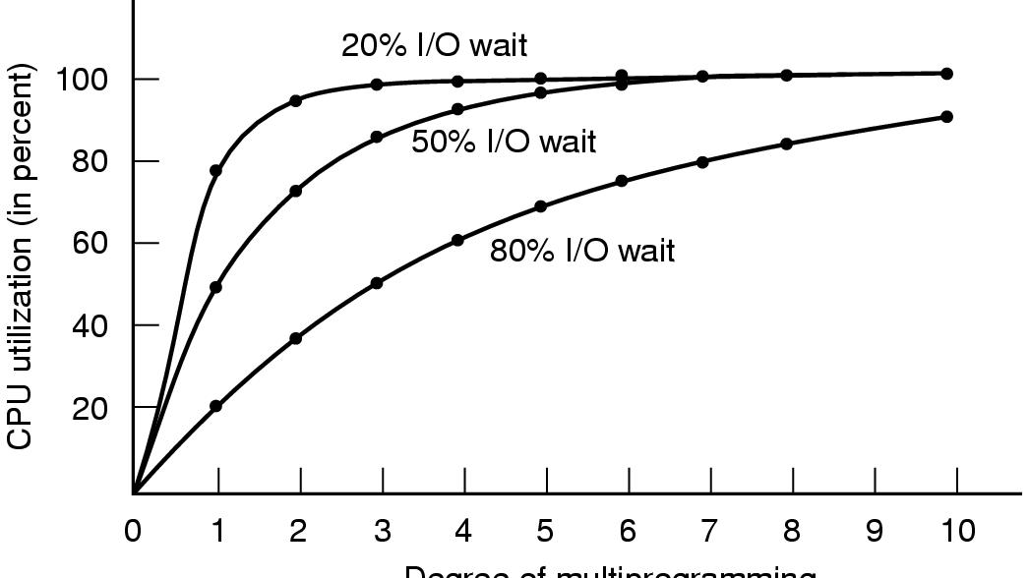
Modeling Multiprogramming
Figure 2-6. CPU utilization as a function of the number of processes in memory.
Tanenbaum, Modern Operating Systems 3 e, (c) 2008 Prentice-Hall, Inc. All rights reserved. 0-13-6006639

Slide 12
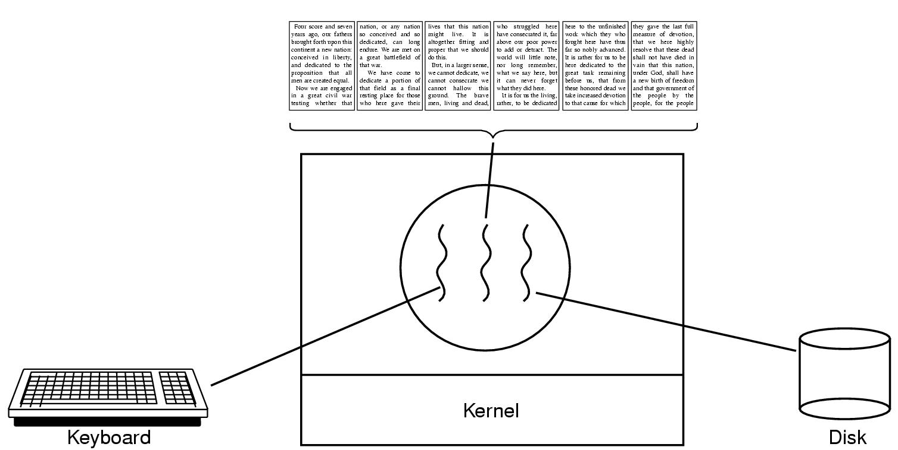
Thread Usage (1)
חלוקה למודולים לוגיים
מענה אלגנטי לטיפול במאורעות אנסיכרוניים
יתרונות
זמן יצירה קטן 1:10
זמן סיום קטן
זמן החלפה קטן
התקשרות מהירה, יש מרחב זיכרון משותף address space
חסרונות (נושאים לטיפול)
תהליכון נחסם, האם חוסם התהליך?
שכפול fork? משכפל רק תהליכון או התהליך
סינכרון.
מימוש ברמת המשתמש
ברמת המערכת הפעלה
הפסקה 15 דקות עד 20:13
A word processor with three threads

Slide 13
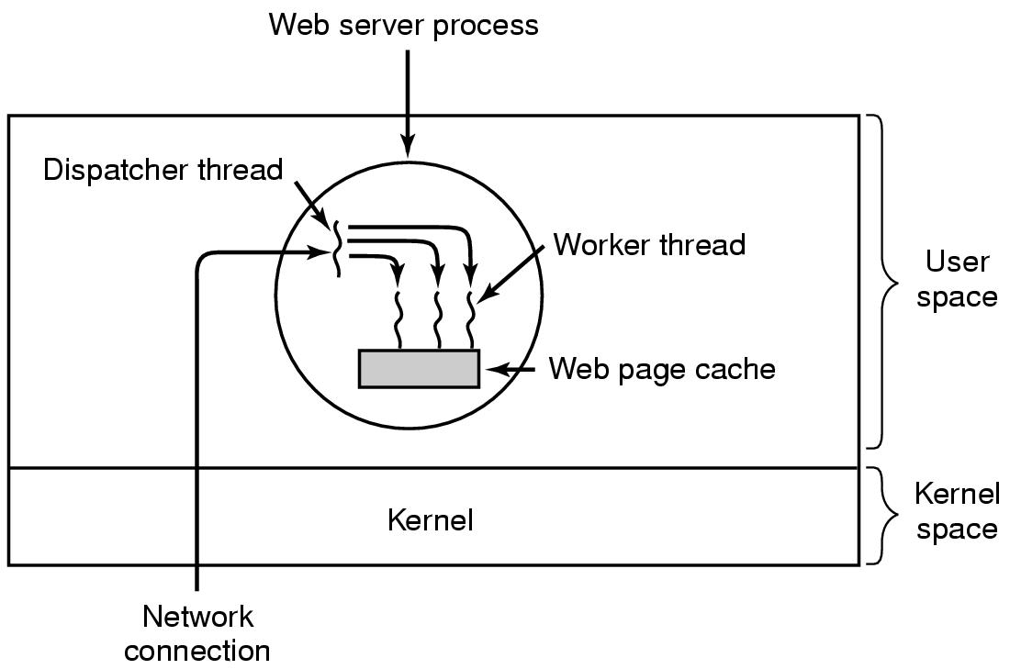
Thread Usage (2)
A multithreaded Web server

Slide 14
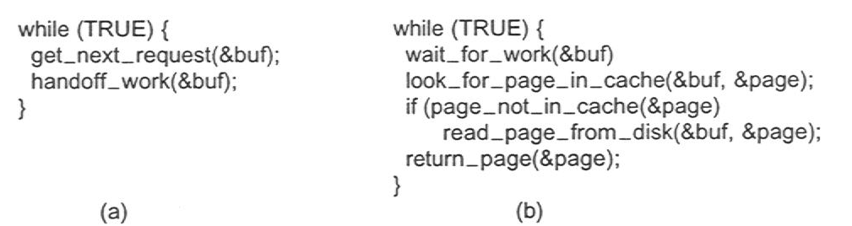
Thread Usage (3)
Rough outline of code for previous slide
(a) Dispatcher thread
(b) Worker thread

Slide 15
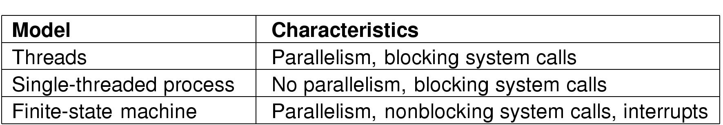
Thread Usage (4)
Three ways to construct a server

Slide 16
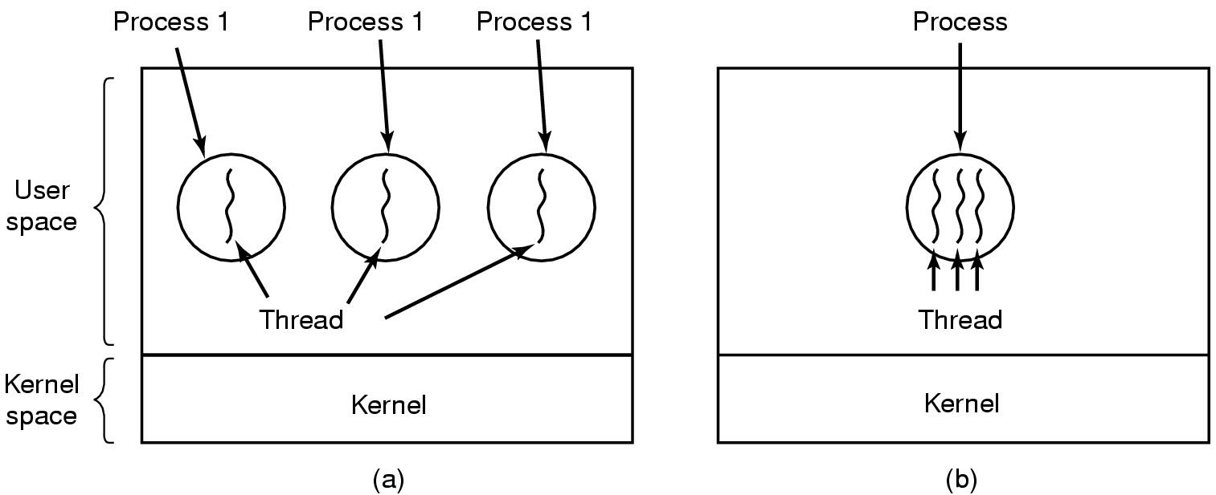
Threads The Thread Model (1)
תהליכונים ברמת הגרעין
תהליכונים ברמת המשתמש
Vfork()
מה יקרה לתהליכון שעושה IO?
תהליכון עושה fork() ?
משתמש במנגנון קיים
ניתן לנצל כמה מעבדים
ניתן לבחור תזמון כרצוננו, שליטה שלנו
אין צורך ב csw אין מעבר לגרעין
ניידות
הגדלת הליבה
(a) Three processes each with one thread
(b) One process with three threads

Slide 17
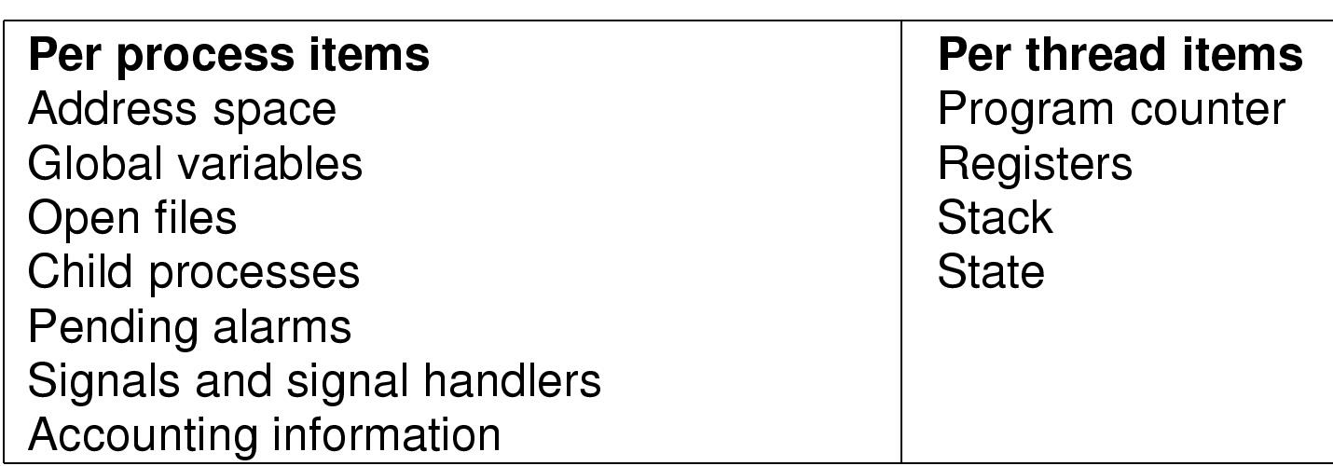
The Thread Model (2)
Items shared by all threads in a process
Items private to each thread
Fib(7)
Fib(17)

Slide 18
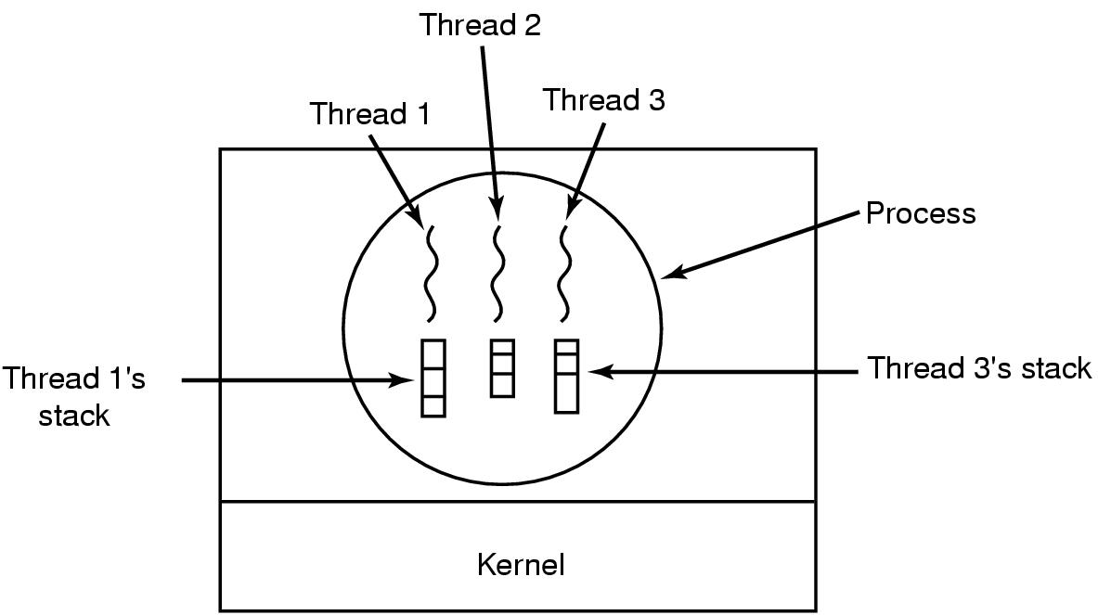
The Thread Model (3)
Each thread has its own stack

Slide 19
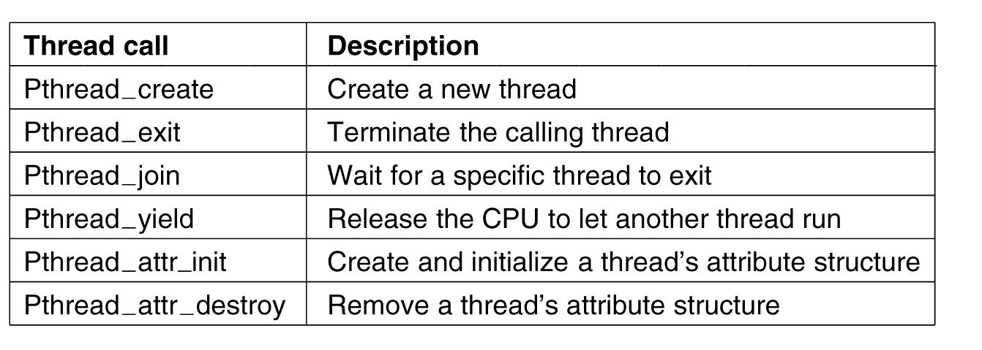
POSIX Threads (1)
Figure 2-14. Some of the Pthreads function calls.
Tanenbaum, Modern Operating Systems 3 e, (c) 2008 Prentice-Hall, Inc. All rights reserved. 0-13-6006639

Slide 20
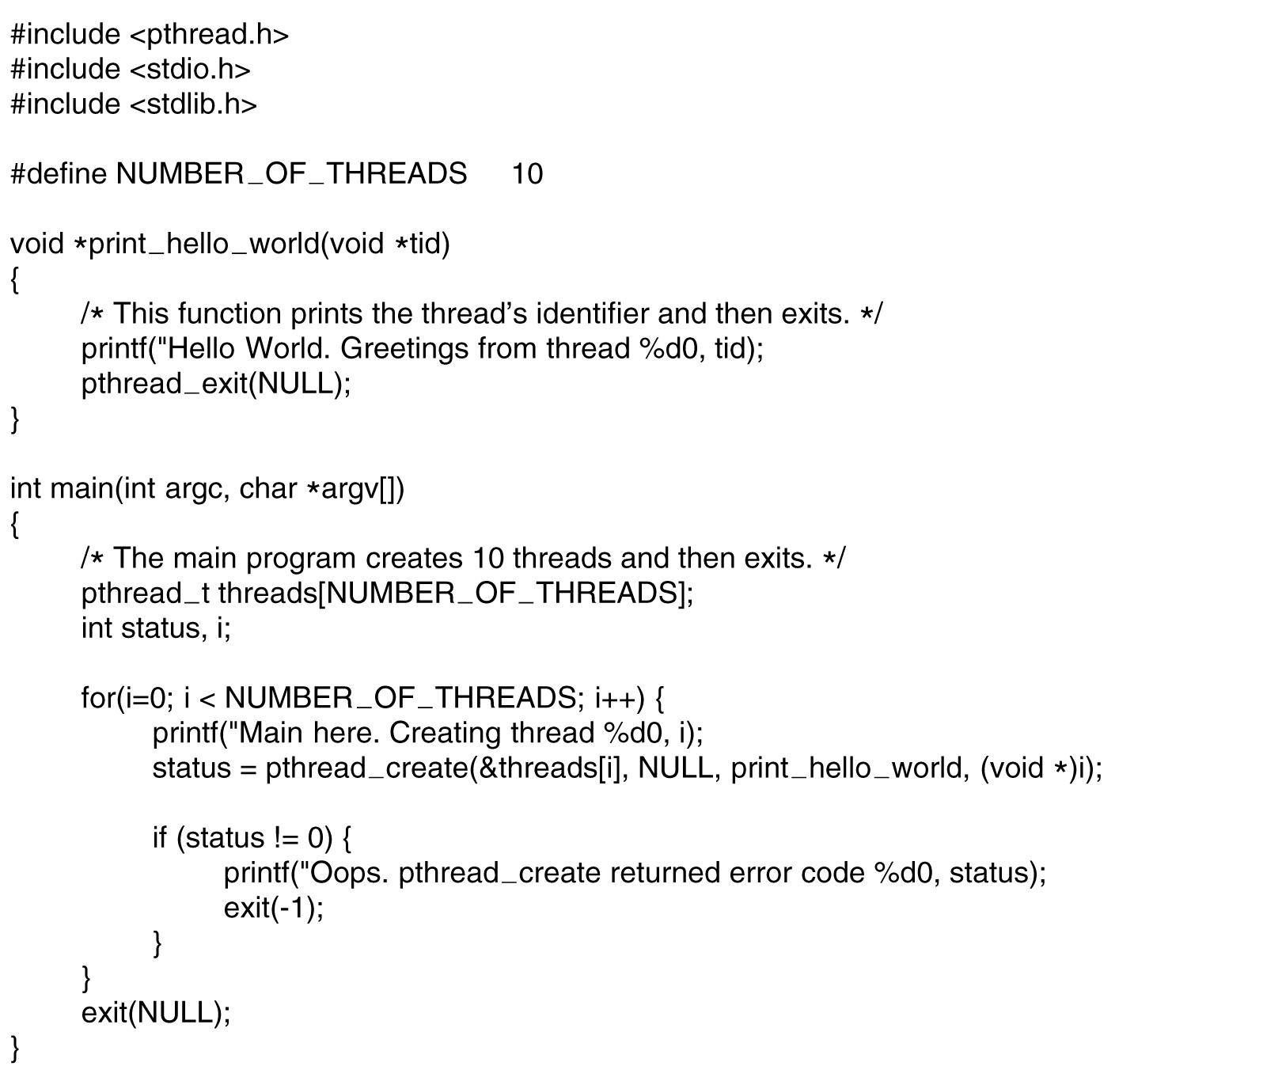
POSIX Threads (2)
. . .
Figure 2-15. An example program using threads.
Tanenbaum, Modern Operating Systems 3 e, (c) 2008 Prentice-Hall, Inc. All rights reserved. 0-13-6006639

Slide 21
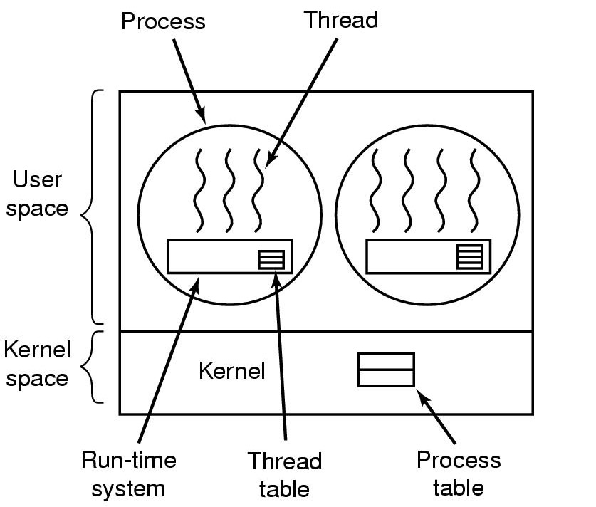
Implementing Threads in User Space
A user-level threads package

Slide 22
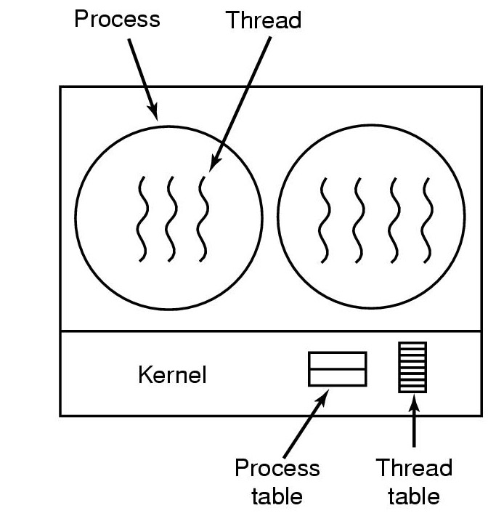
Implementing Threads in the Kernel
A threads package managed by the kernel

Slide 23
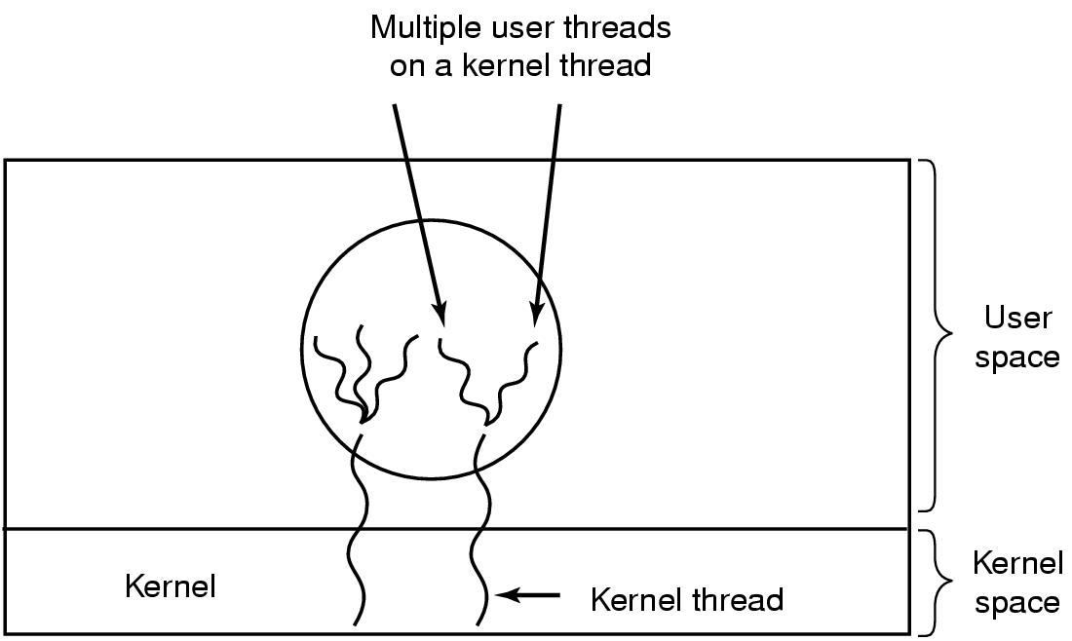
Hybrid Implementations
Multiplexing user-level threads onto kernel- level threads

Slide 24
Scheduler Activations
Goal – mimic functionality of kernel threads
gain performance of user space threads
Avoids unnecessary user/kernel transitions
Kernel assigns virtual processors to each process
lets runtime system allocate threads to processors
Problem: Fundamental reliance on kernel (lower layer)
calling procedures in user space (higher layer)

Slide 25
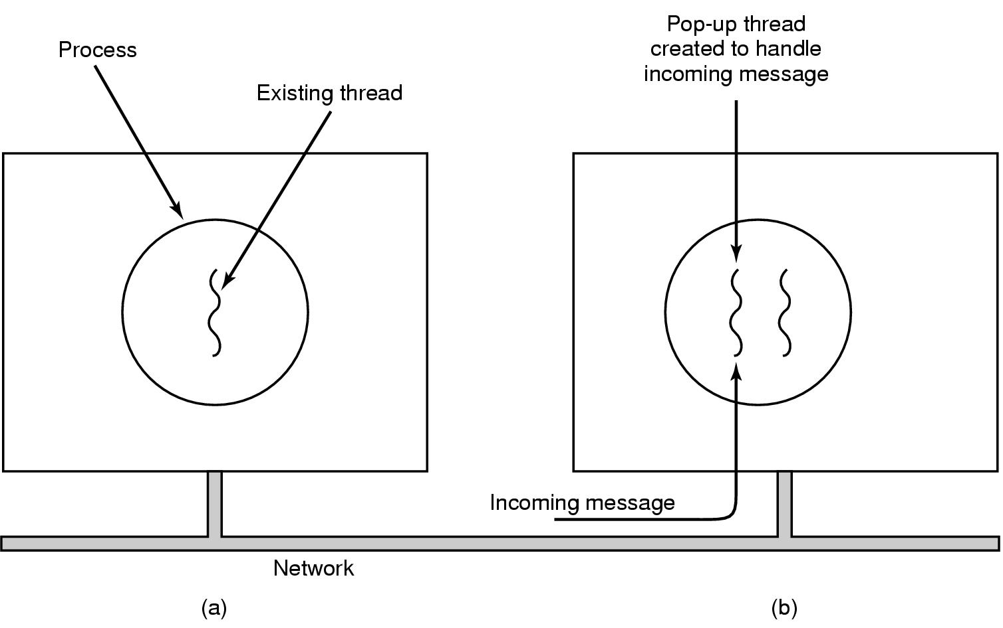
Pop-Up Threads
Creation of a new thread when message arrives
(a) before message arrives
(b) after message arrives

Slide 26
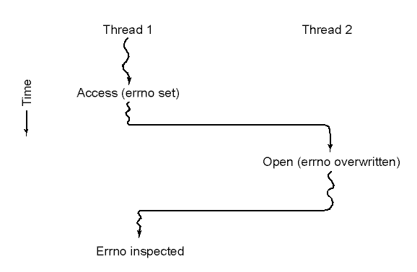
Making Single-Threaded Code Multithreaded (1)
Conflicts between threads over the use of a global variable

Slide 27
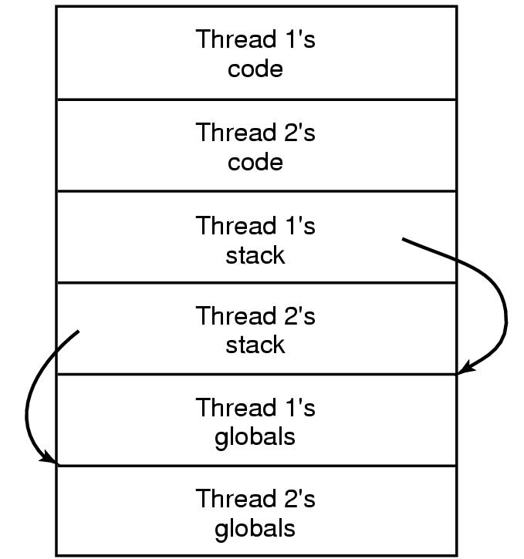
Making Single-Threaded Code Multithreaded (2)
Threads can have private global variables

Slide 28
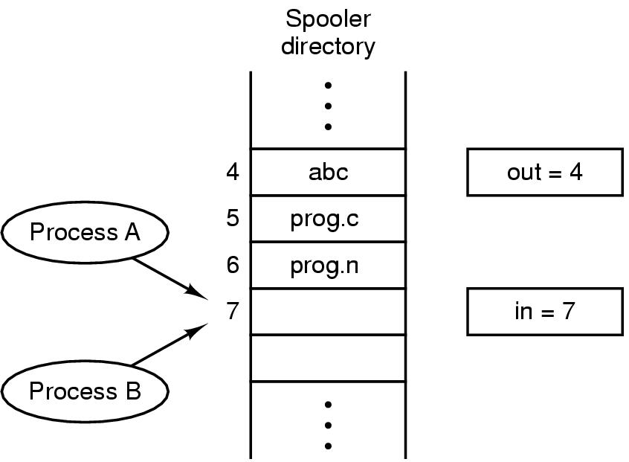
Interprocess Communication Race Conditions
קטע קריטי
פעולה אטומית
מניעה הדדית
Print(str)
Enque(string str){
a[in]=str
in++
}
csw
c.s()
Print(str)
tal.txt
Print(str)
זבל
Yakir.txt
Two processes want to access shared memory at same time

Slide 29
00 FF
00 01
00 00
00
X= יתרה
משיכה 800 ש"ח
יתרה חדשה
Z=x-y
X=z

Slide 30
Critical Regions (1)
Four conditions to provide mutual exclusion
No two processes simultaneously in critical region
No assumptions made about speeds or numbers of CPUs
No process running outside its critical region may block another process
No process must wait forever to enter its critical region
פתרון
סביר

Slide 31
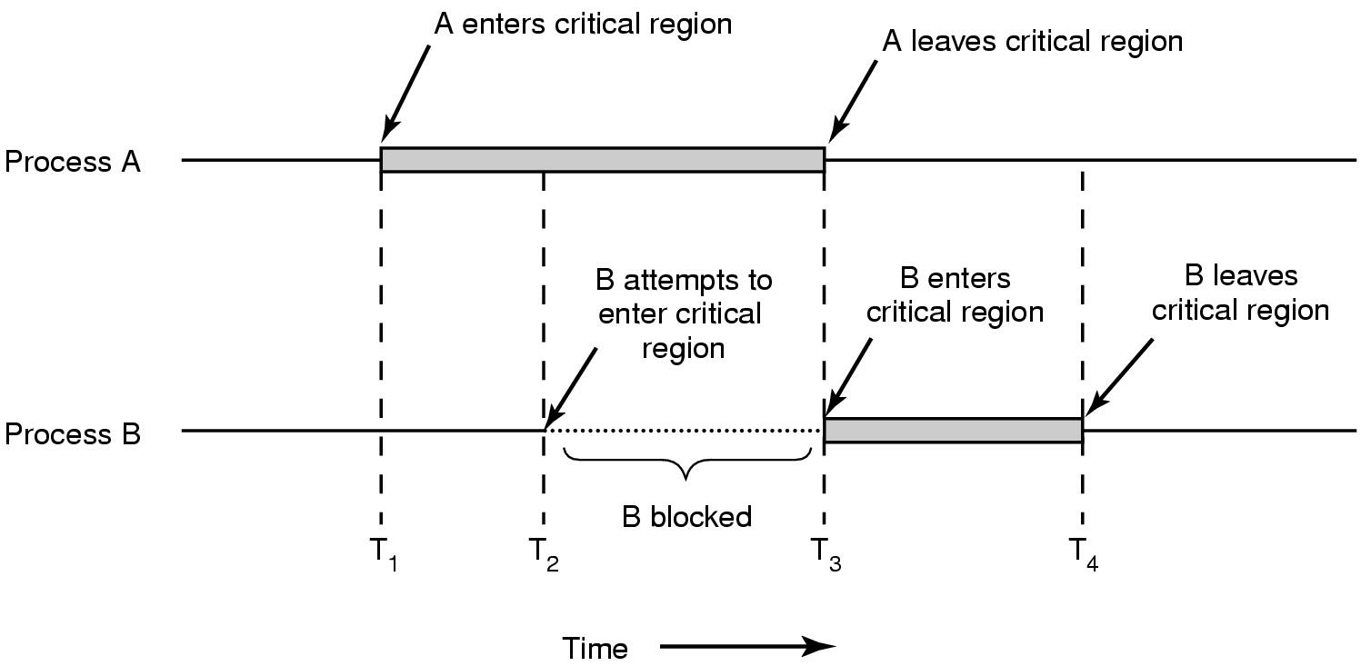
Critical Regions (2)
Mutual exclusion using critical regions

Slide 32
Mutual Exclusion with Busy Waiting
Proposals for achieving mutual exclusion:
Disabling interrupts
Lock variables
Strict alternation
Peterson's solution
The TSL instruction
אסור לתת למשתמש כזה כח !!! ואם ישכח להחזיר אז המחשב נתקע.
מערכת ההפעלה משתמשת בטריק זה של ביטול פסיקות לזמן קצר מאוד.
* לא יעבוד על מספר מעבדים
While(lock) // if(lock==0) break
;
lock=1 //assuming lock is =0
c.s()
Lock=0
CSW
CSW
Tanenbaum, Modern Operating Systems 3 e, (c) 2008 Prentice-Hall, Inc. All rights reserved. 0-13-6006639

Slide 33
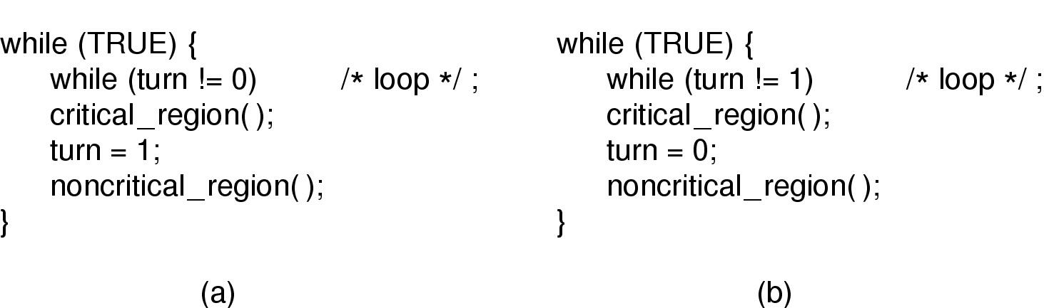
Strict Alternation
Proposed solution to critical region problem
(a) Process 0. (b) Process 1.

Slide 34
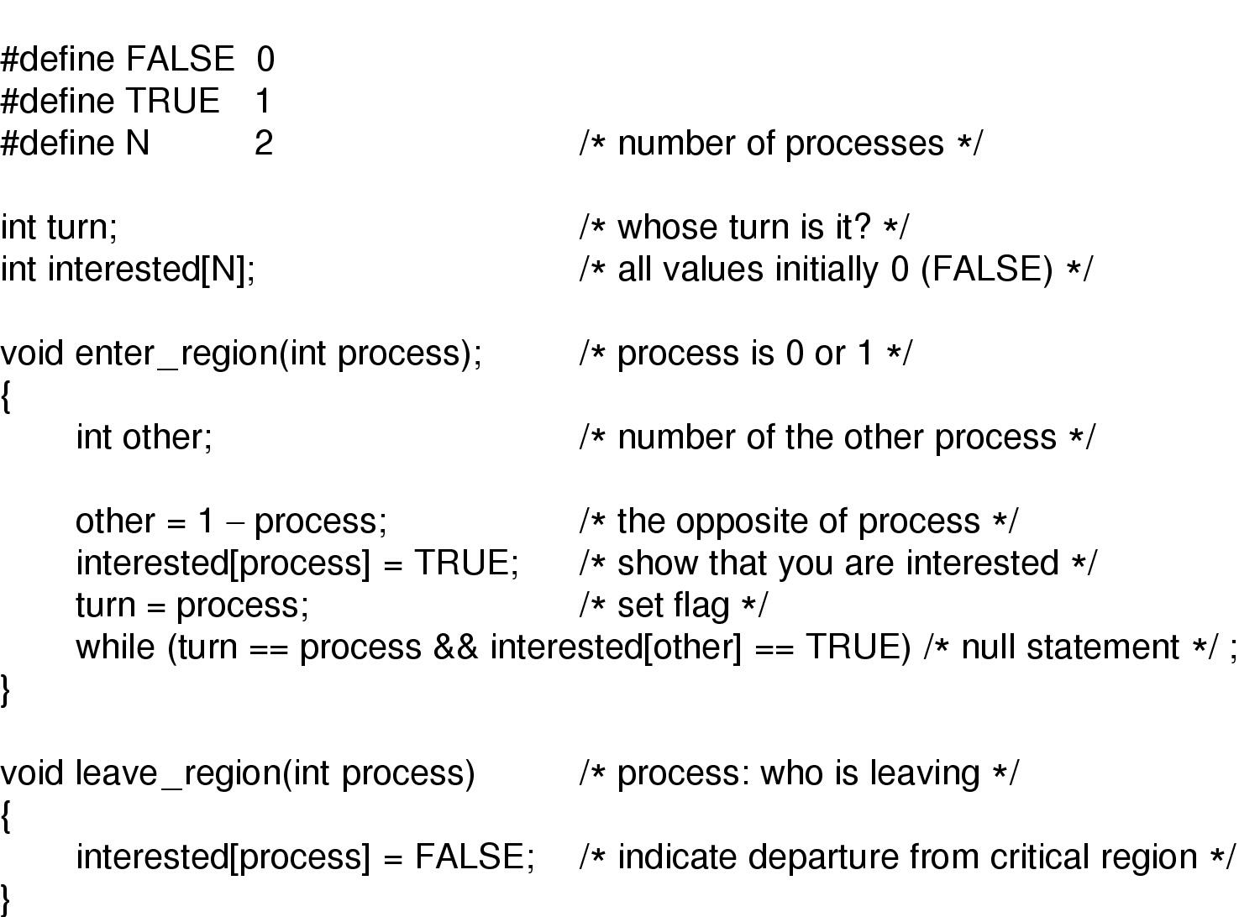
Peterson's Solution
המתנה פעילה
היפוך קדימויות
Peterson's solution for achieving mutual exclusion

Slide 35
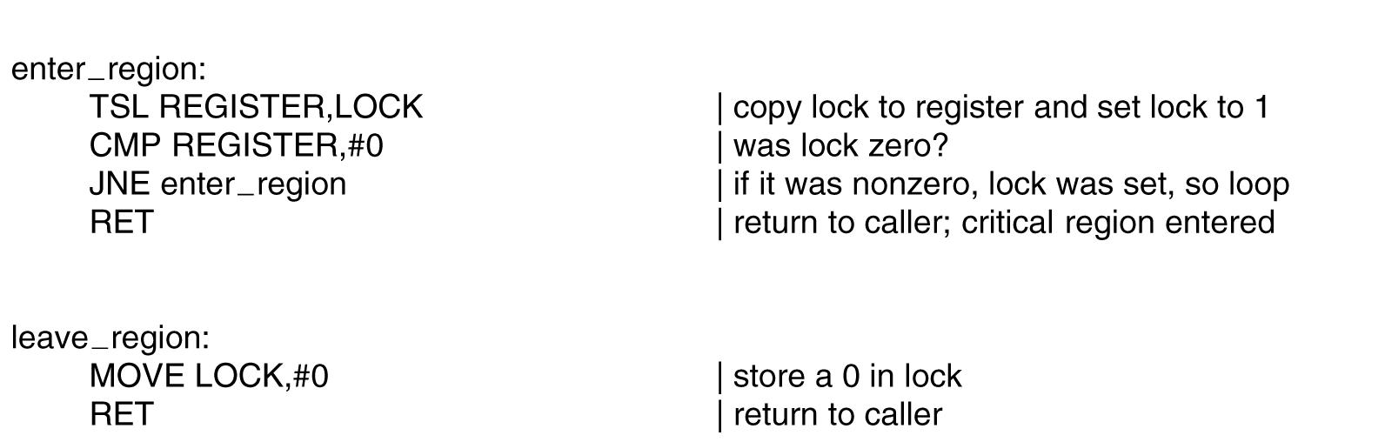
The TSL Instruction
tsl register=lock=1
Entering and leaving a critical region using the
TSL instruction

Slide 36
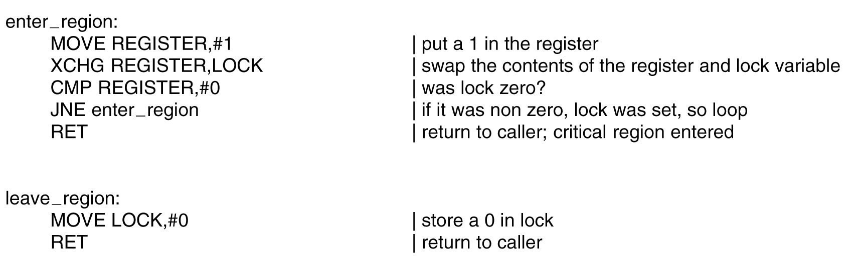
The TSL Instruction (2)
Figure 2-26. Entering and leaving a critical region using the XCHG instruction.
Tanenbaum, Modern Operating Systems 3 e, (c) 2008 Prentice-Hall, Inc. All rights reserved. 0-13-6006639

Slide 37
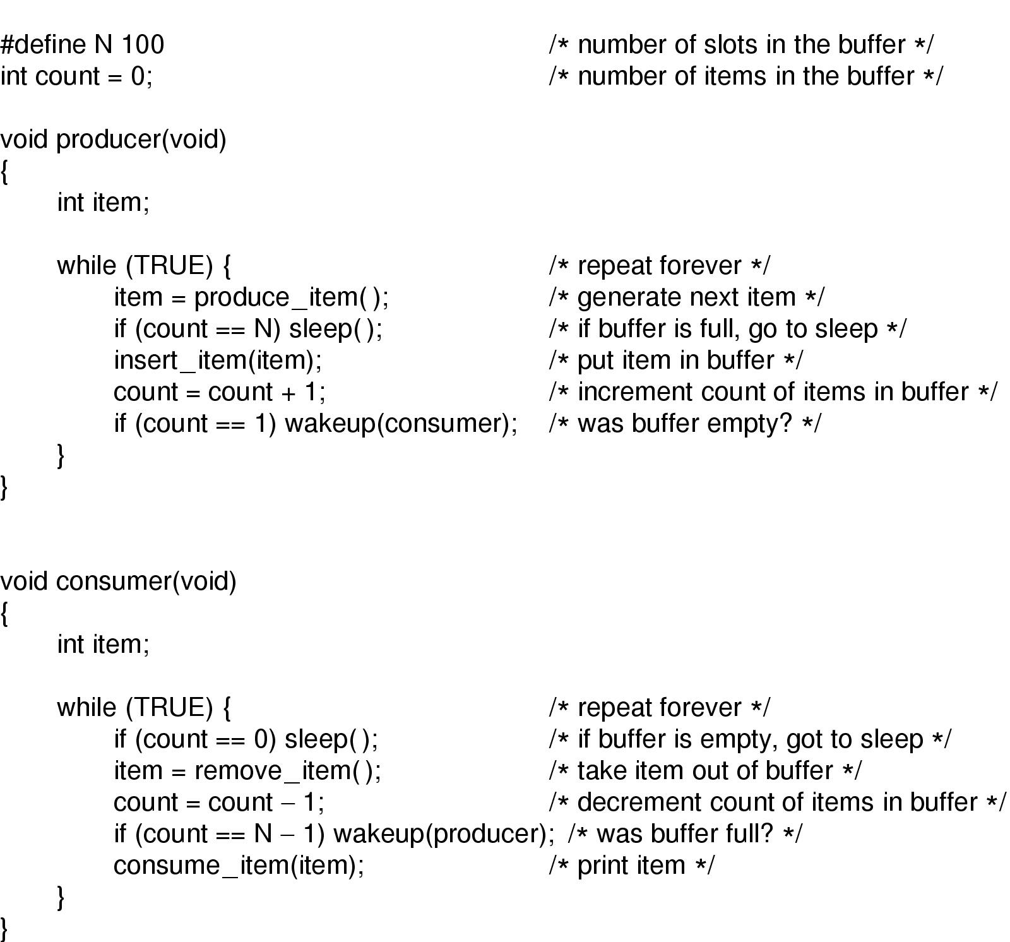
Sleep and Wakeup
c.sw
Producer-consumer problem with fatal race condition

Slide 38
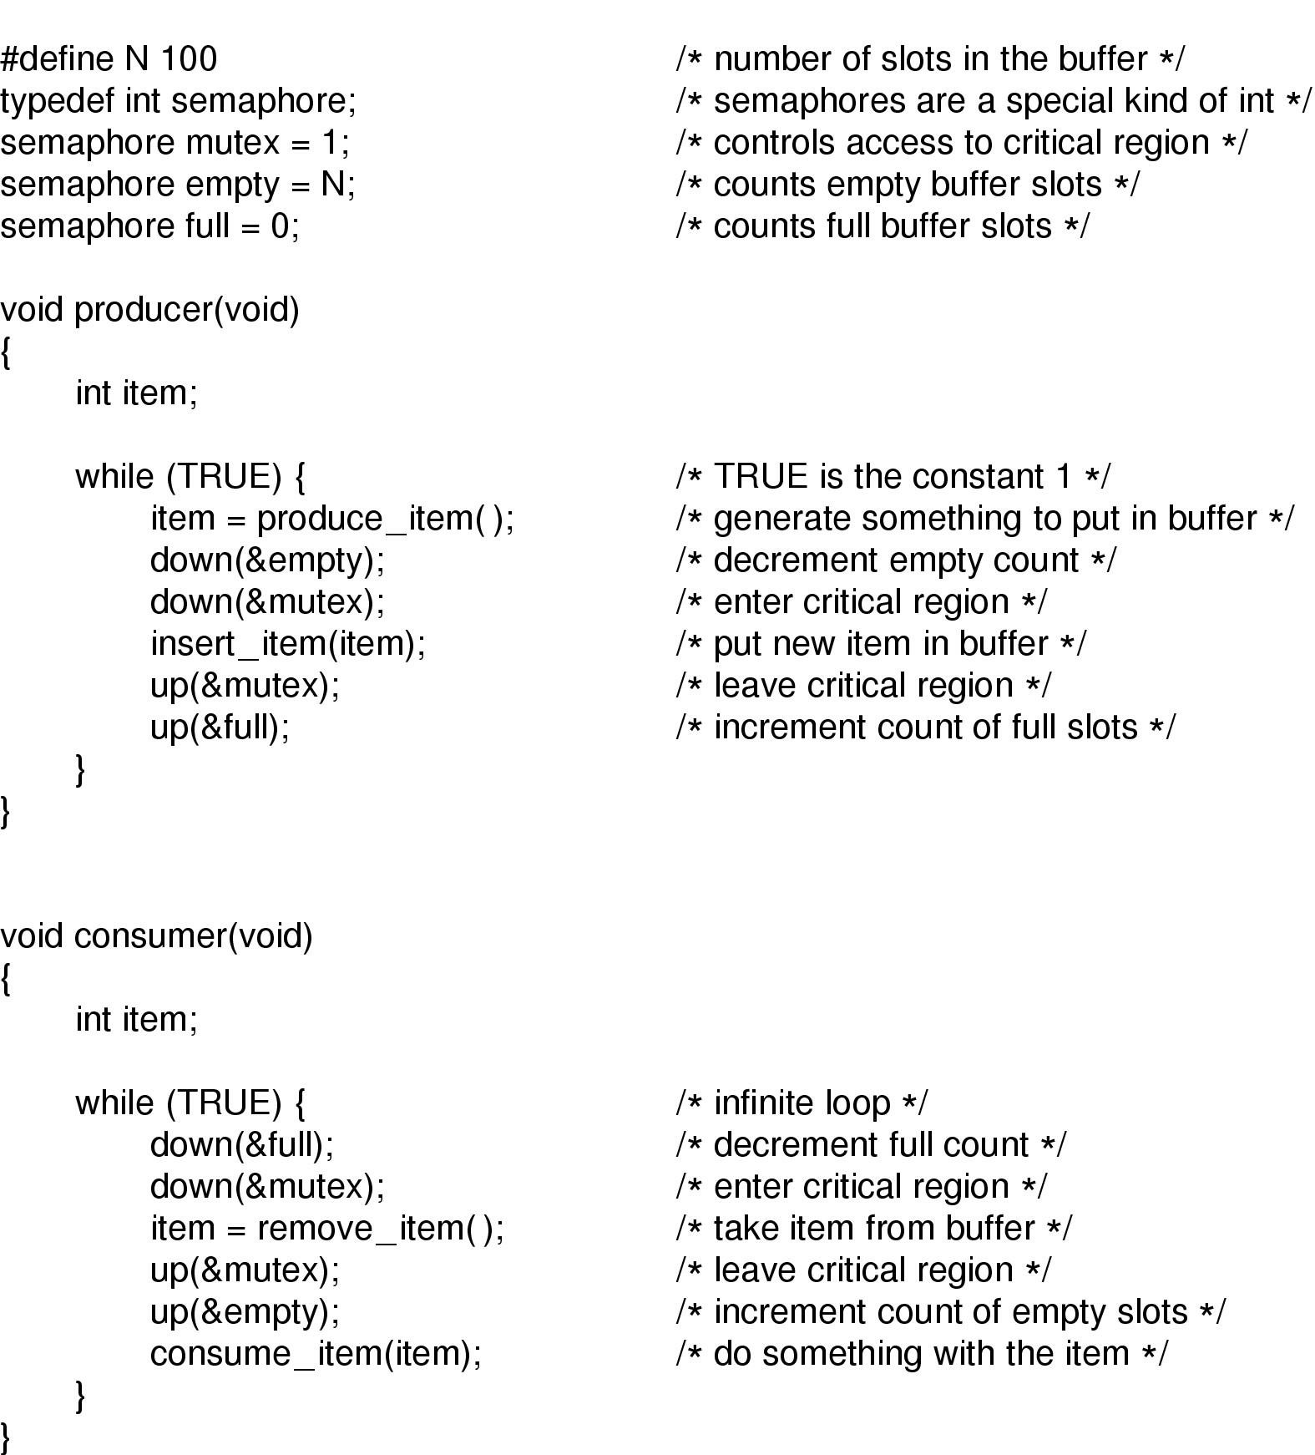
Semaphores
c.sw
Down(int sem){
while (sem==0)
yield נרדמים על הסמפור
sem--
up(int sem){
sem++
פרוטוקול כניסה לקטע קריטי
down(mutex){
c.s();
up(mutex){
c.sc()
The producer-consumer problem using semaphores

Slide 39
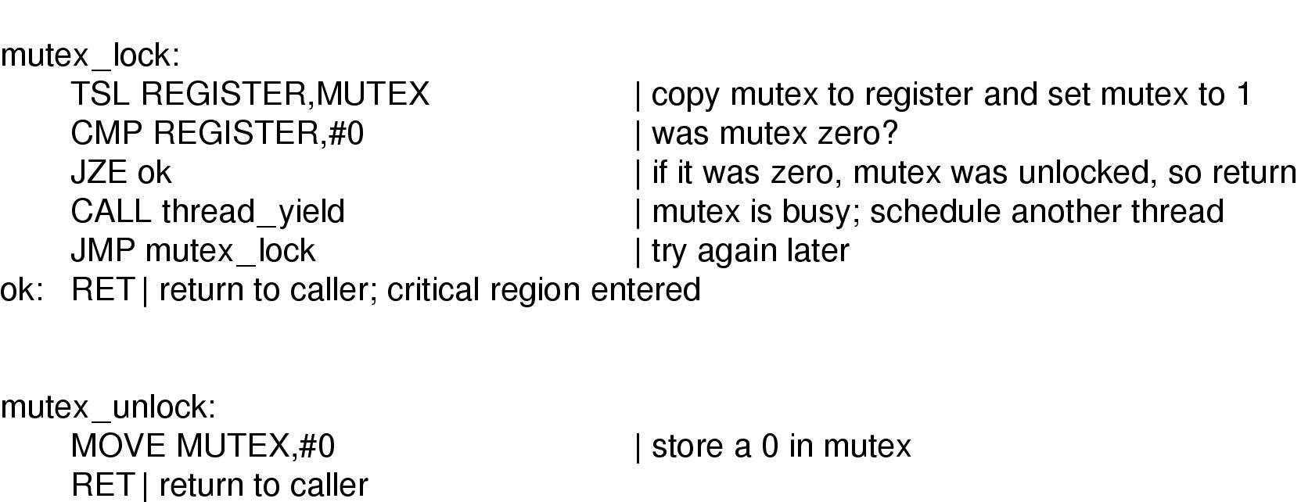
Mutexes
Implementation of mutex_lock and mutex_unlock

Slide 40
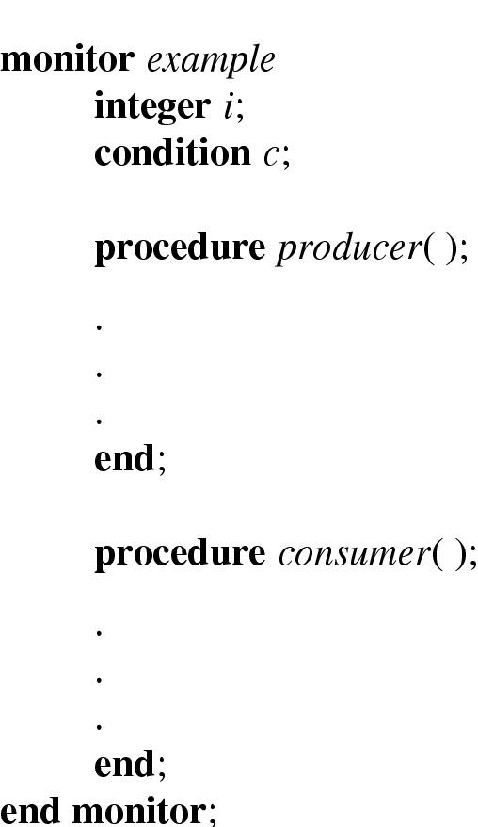
Monitors (1)
הפסקה רבע שעה
19:50
Example of a monitor

Slide 41
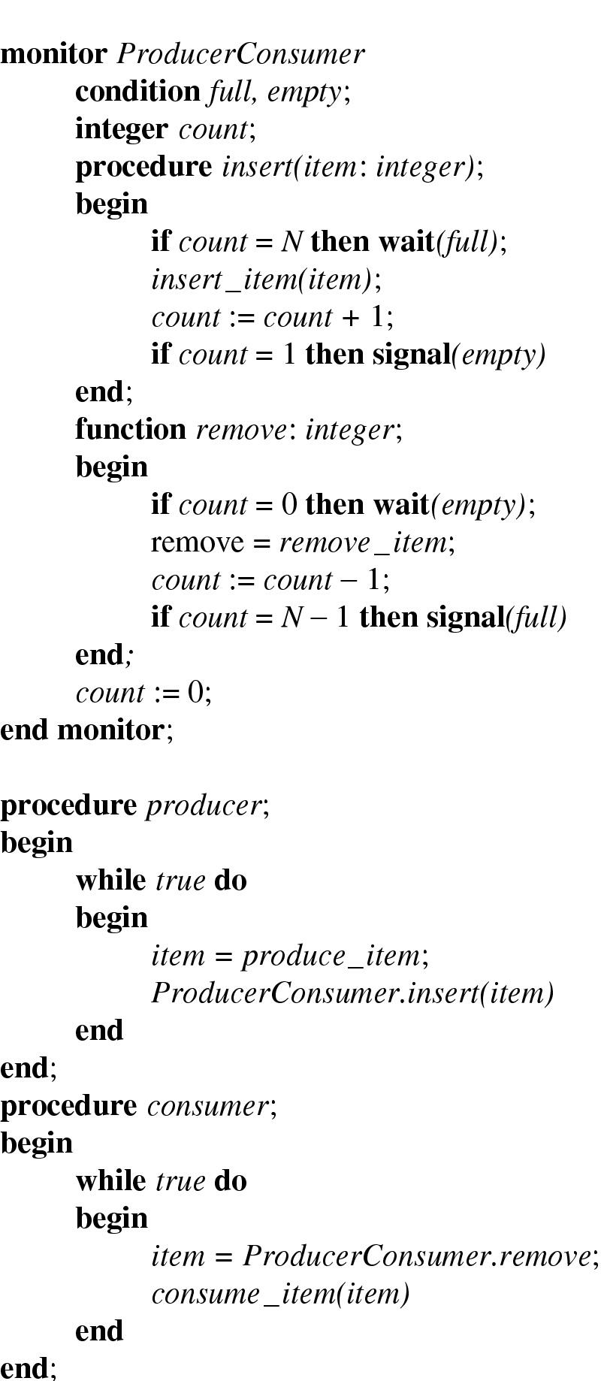
Monitors (2)
Outline of producer-consumer problem with monitors
only one monitor procedure active at one time
buffer has N slots

Slide 42
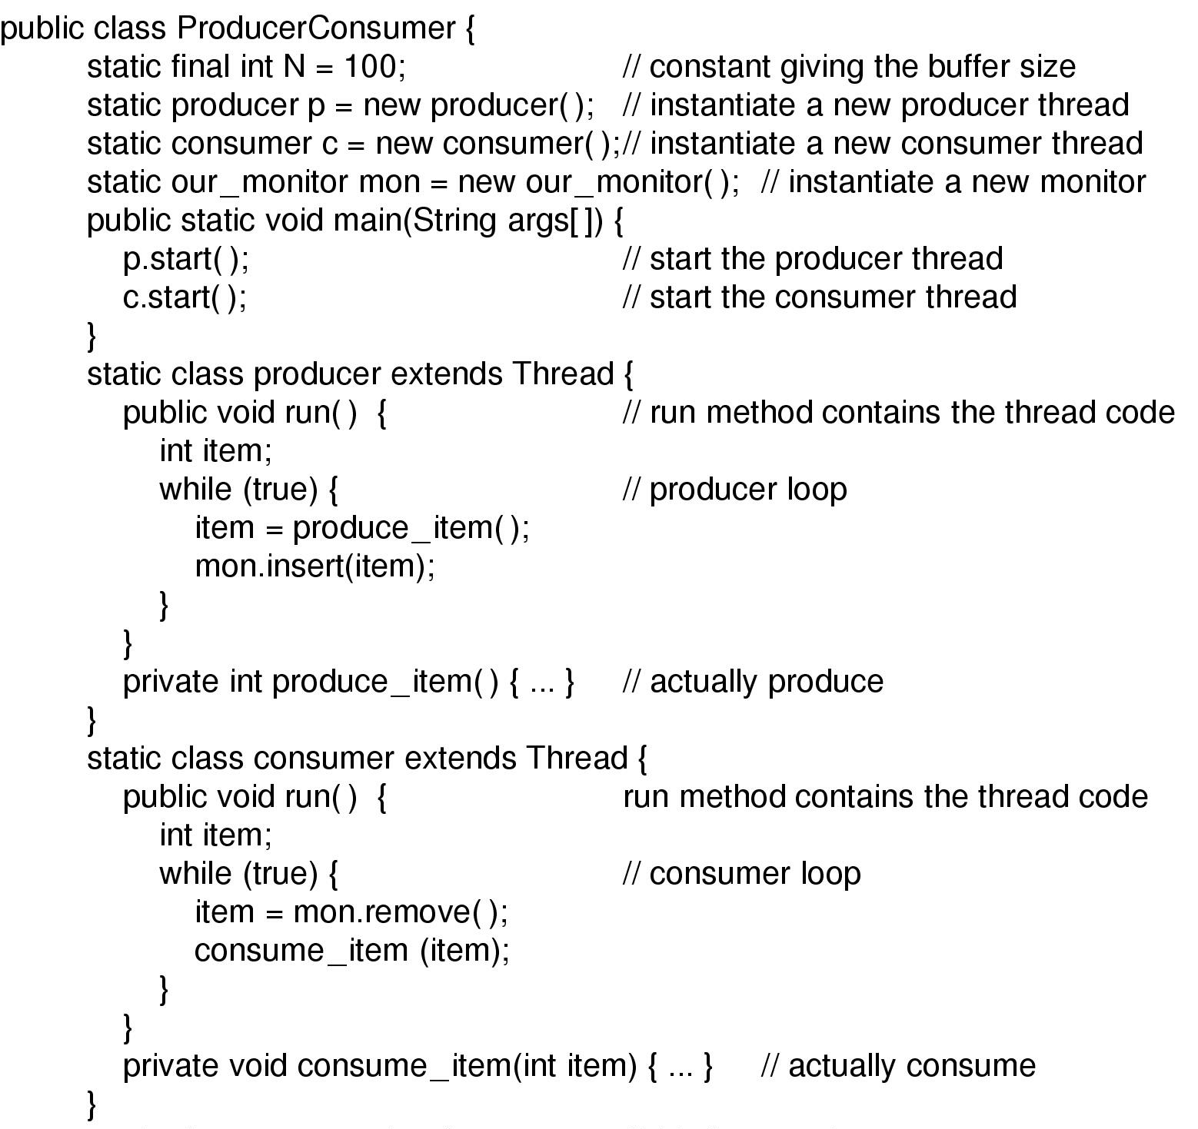
Monitors (3)
Solution to producer-consumer problem in Java (part 1)

Slide 43
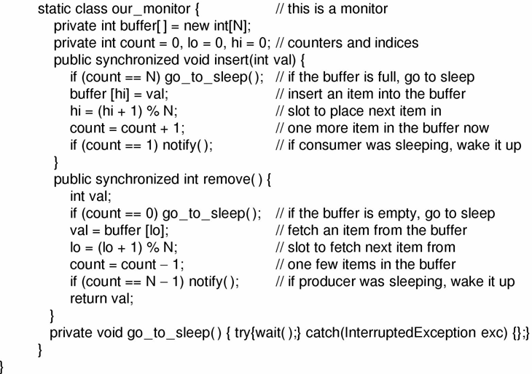
Monitors (4)

Slide 44
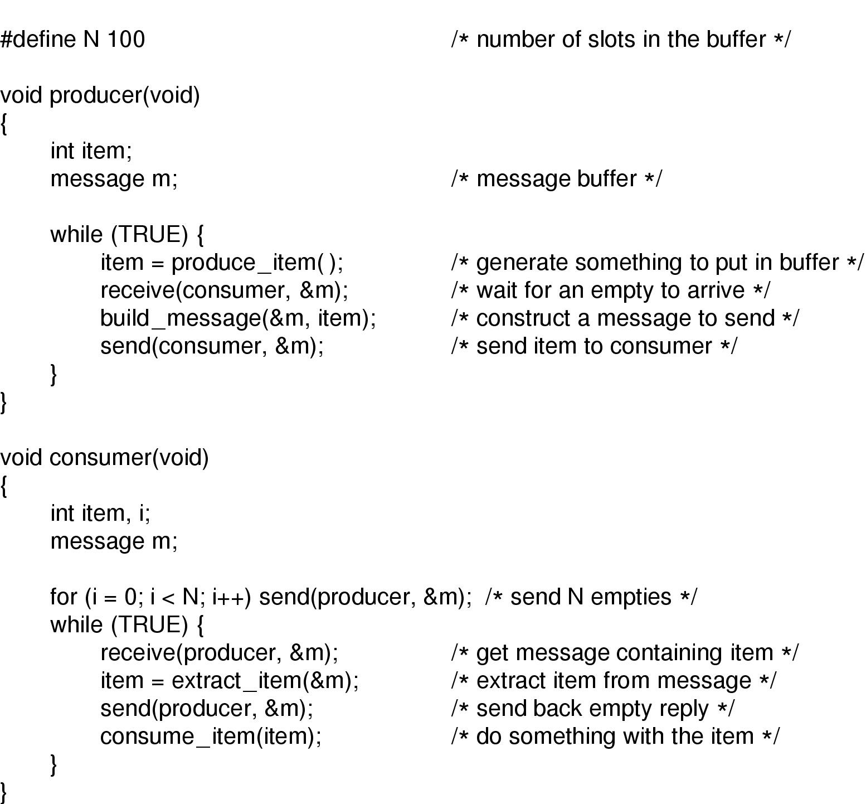
Message Passing
תיבת דואר
מפגש
The producer-consumer problem with N messages

Slide 45
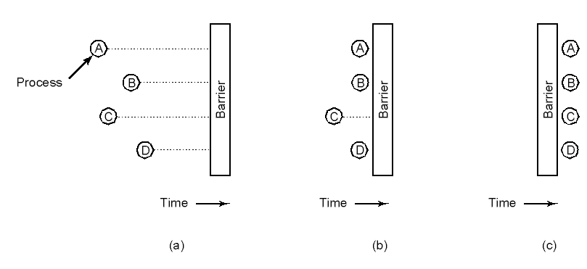
Barriers
Use of a barrier
processes approaching a barrier
all processes but one blocked at barrier
last process arrives, all are let through

Slide 46

Dining Philosophers (1)
Philosophers eat/think
Eating needs 2 forks
Pick one fork at a time
How to prevent deadlock

Slide 47
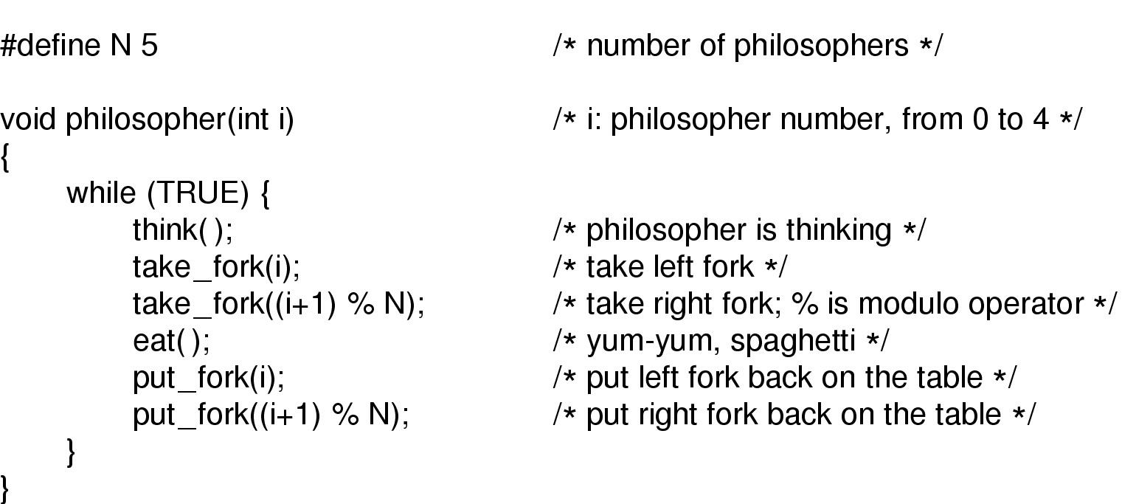
Dining Philosophers (2)
A nonsolution to the dining philosophers problem

Slide 48
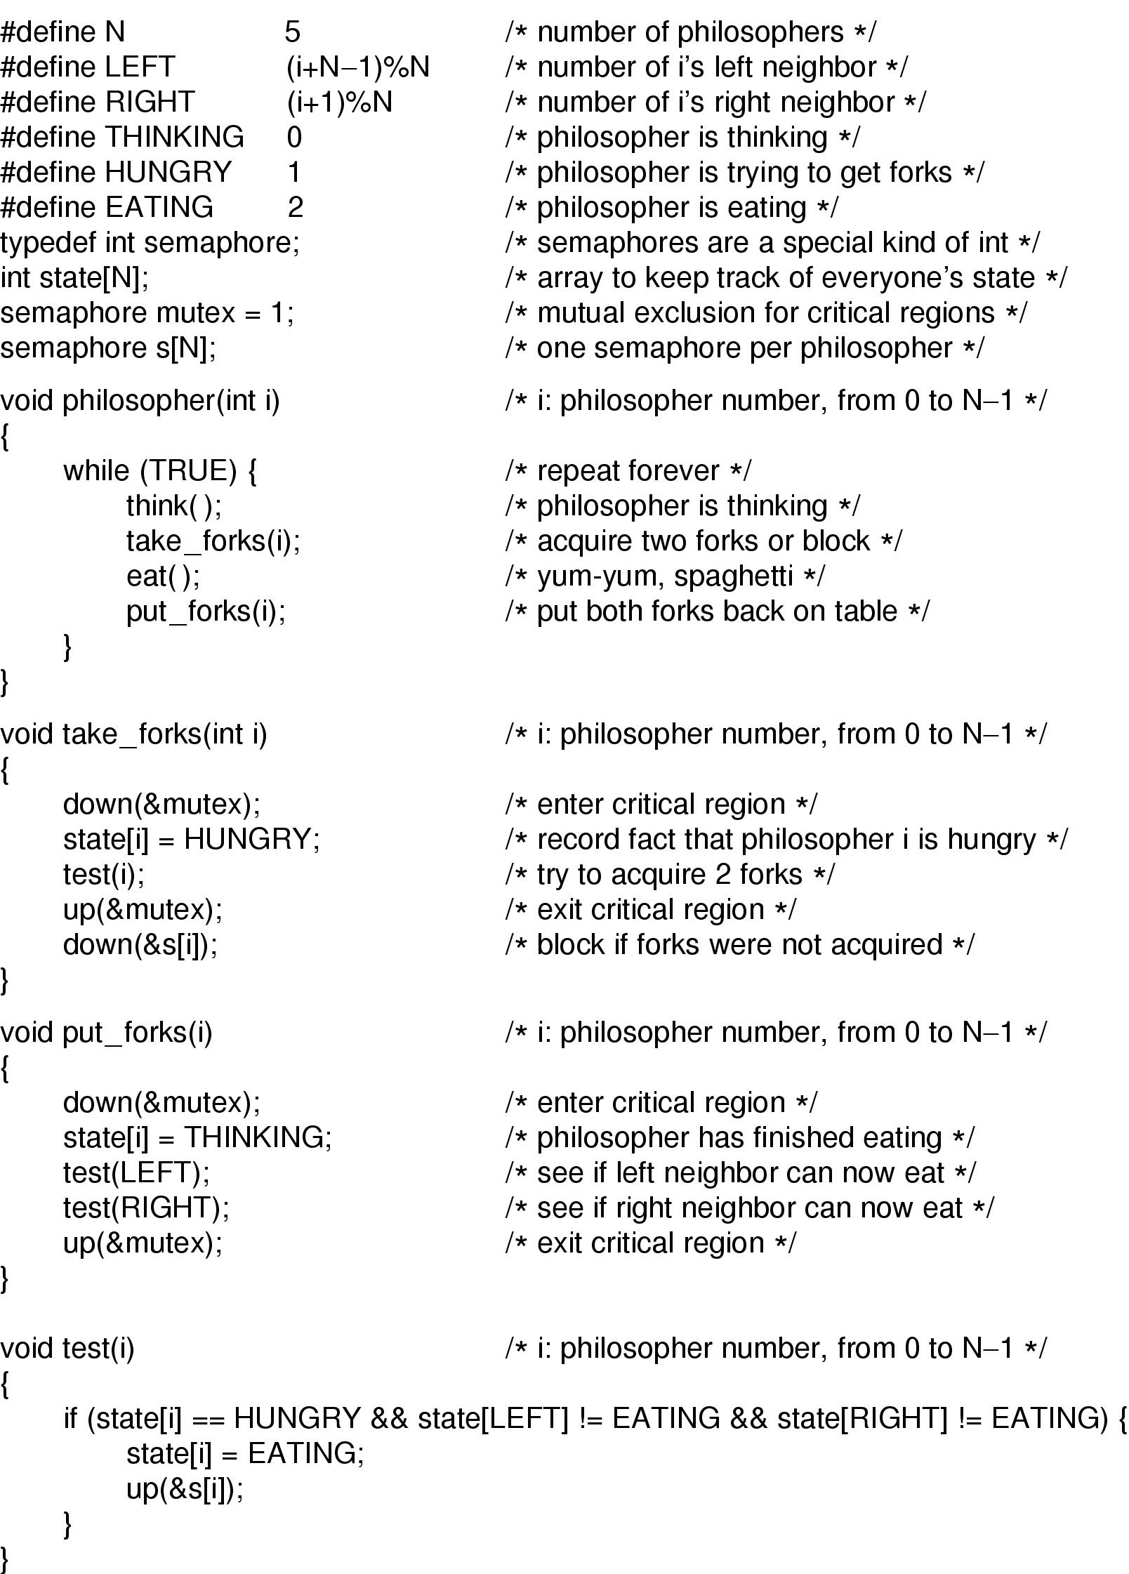
Dining Philosophers (3)
Solution to dining philosophers problem (part 1)

Slide 49
Dining Philosophers (4)
Solution to dining philosophers problem (part 2)

Slide 50
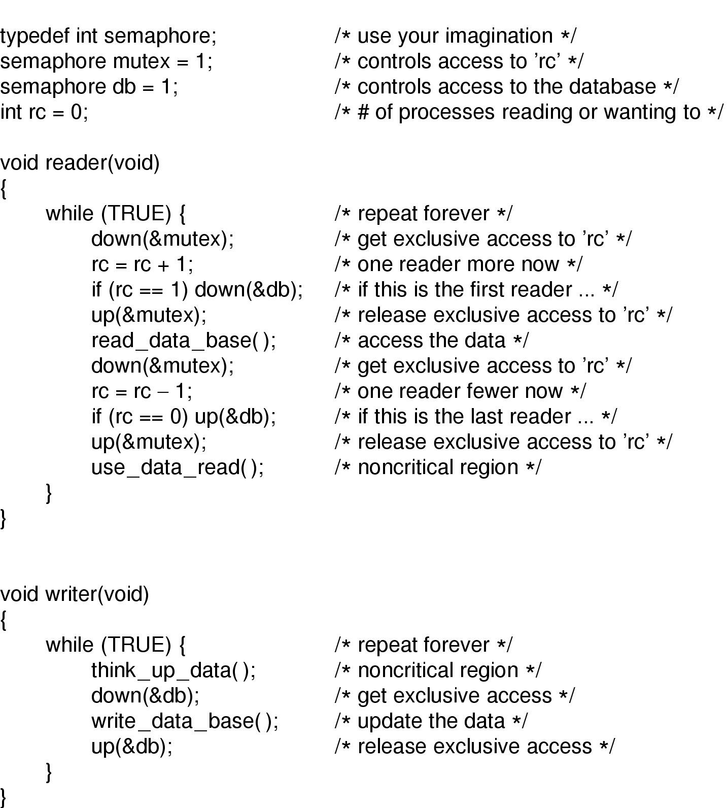
The Readers and Writers Problem
A solution to the readers and writers problem

Slide 51
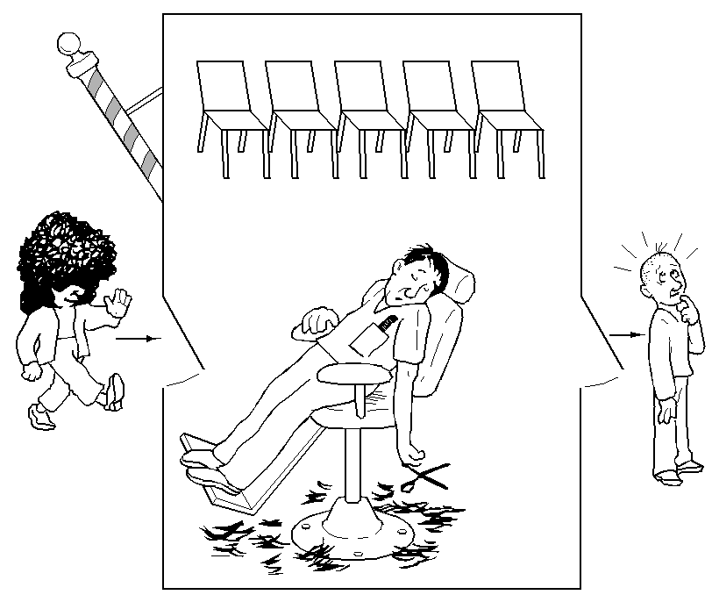
The Sleeping Barber Problem (1)

Slide 52
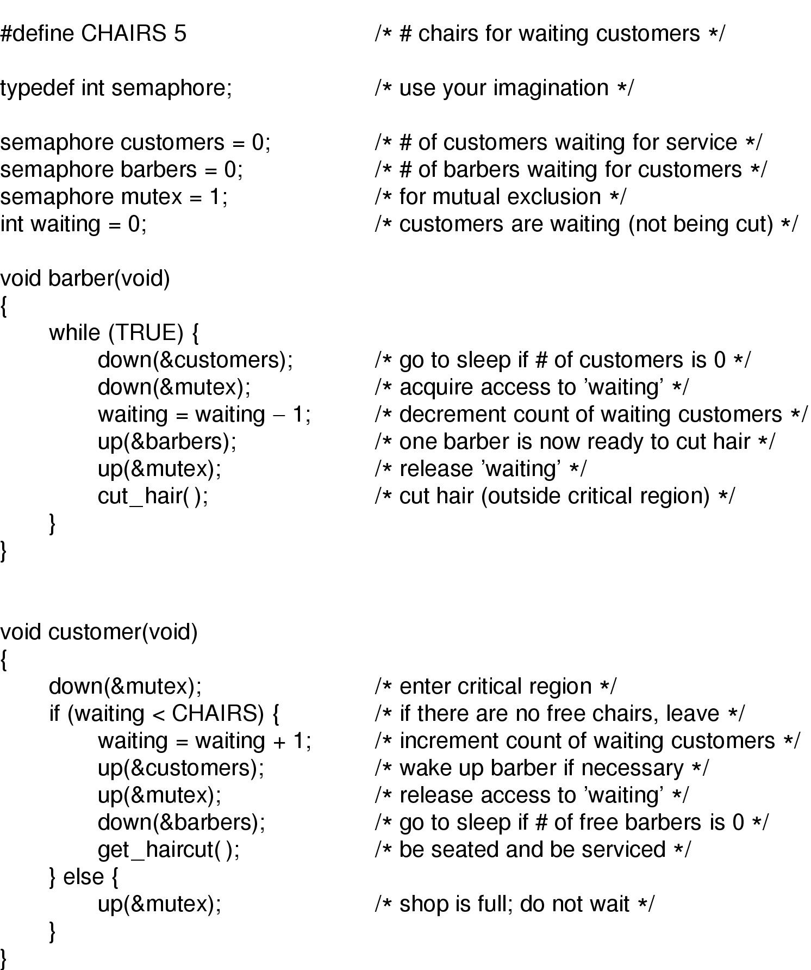
The Sleeping Barber Problem (2)
Solution to sleeping barber problem.

Slide 53
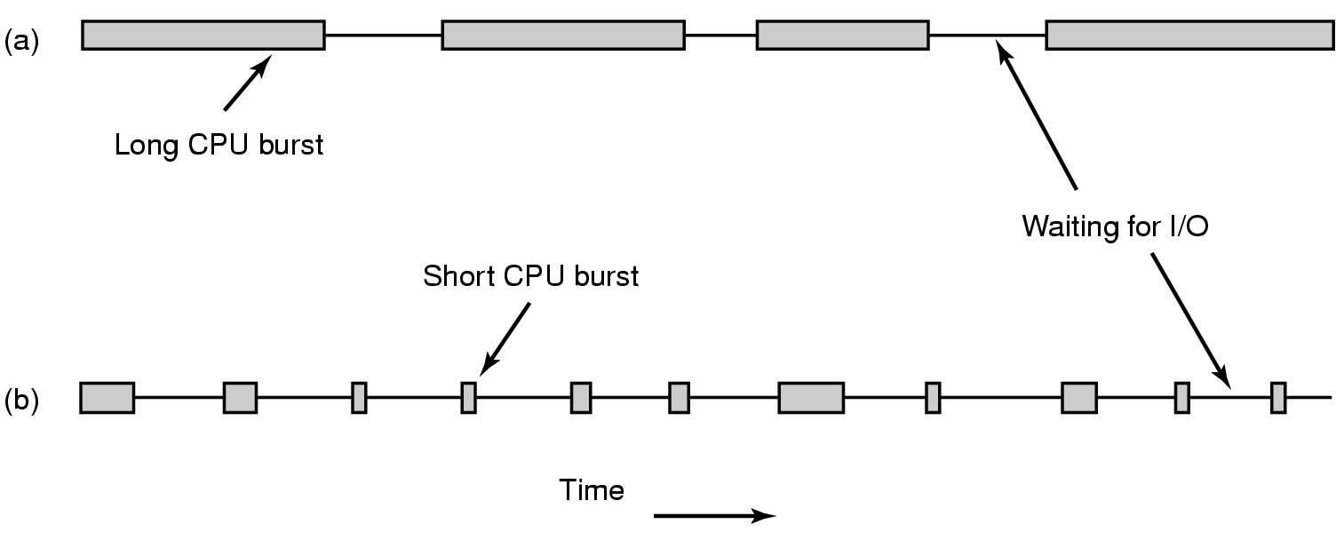
Scheduling Introduction to Scheduling (1)
Bursts of CPU usage alternate with periods of I/O wait
a CPU-bound process
an I/O bound process

Slide 54
Categories of Scheduling Algorithms
Batch
Interactive
Real time
ללא מגע יד אדם, עבודות ידועות מראש והזמן שלהם
Preemptive
Non preemptive
משתמש פעיל מזין קלט
Tanenbaum, Modern Operating Systems 3 e, (c) 2008 Prentice-Hall, Inc. All rights reserved. 0-13-6006639

Slide 55
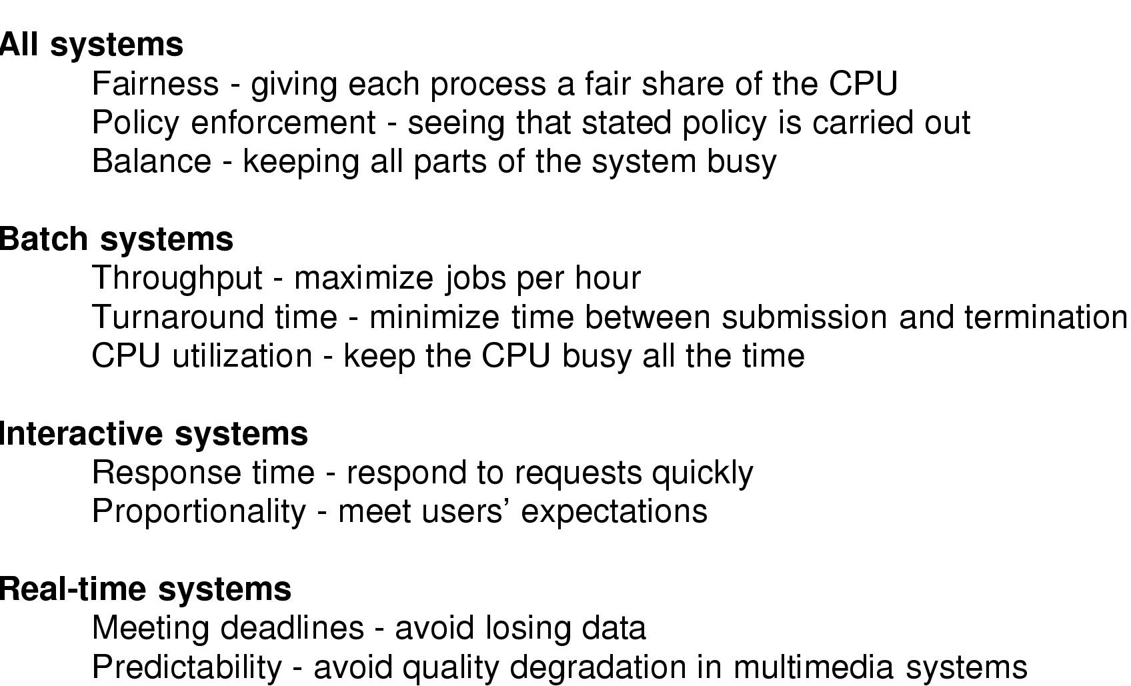
Introduction to Scheduling (2)
תפוקה
זמן שהייה
Hard RT
Soft RT
Scheduling Algorithm Goals

Slide 56
Scheduling in Batch Systems
First-come first-served
Shortest job first
Shortest remaining Time next
Tanenbaum, Modern Operating Systems 3 e, (c) 2008 Prentice-Hall, Inc. All rights reserved. 0-13-6006639

Slide 57
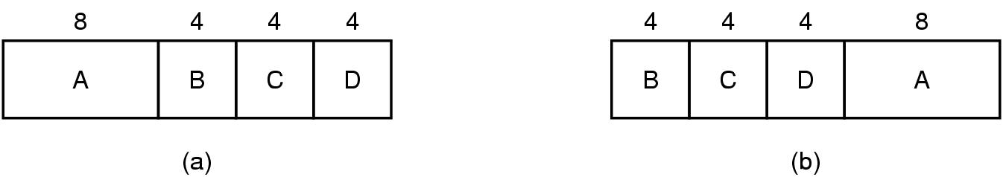
Scheduling in Batch Systems (1)
תהליך | זמן הגעה | CPU | התחלה | סיום | זמן שהייה | SJF
A | 0 | 8 | 12 | 20 | 20 | =44/4
B | 0 | 4 | 0 | 4 | 4 | =11
C | 0 | 4 | 4 | 8 | 8
D | 0 | 4 | 8 | 12 | 12
תהליך | זמן הגעה | CPU | התחלה | סיום | זמן שהייה | זמן שהייה ממוצע
A | 0 | 8 | 0 | 8 | 8 | =56/4
B | 0 | 4 | 8 | 12 | 12 | =14
C | 0 | 4 | 12 | 16 | 16
D | 0 | 4 | 16 | 20 | 20
An example of shortest job first scheduling

Slide 58
תהליך | זמן הגעה | CPU | התחלה | סיום | זמן שהייה | זמן שהייה ממוצע
A | 0 | 2 | 0 | 2 | 2 | =17/4
B | 0 | 4 | 2 | 6 | 6
C | 3 | 1 | 6 | 7 | 4
D | 3 | 1 | 7 | 8 | 5
תהליך | זמן הגעה | CPU | התחלה | סיום | זמן שהייה | SJF
A | 0 | 8 | 12 | 20 | 20 | =44/4
B | 0 | 4 | 0 | 4 | 4 | =11
C | 0 | 4 | 4 | 8 | 8
D | 0 | 4 | 8 | 12 | 12
תהליך | זמן הגעה | CPU | התחלה | סיום | זמן שהייה | זמן שהייה ממוצע
A | 0 | 2 | 0 | 2 | 2 | =14/4
B | 0 | 4 | 5 | 9 | 9
C | 3 | 1 | 3 | 4 | 1
D | 3 | 1 | 4 | 5 | 2
An example of shortest job first scheduling

Slide 59
Shortest remaining Time next PREEMPTIVE
תהליך | זמן הגעה | CPU | התחלה | סיום | זמן שהייה | זמן שהייה ממוצע
A | 0 | 2 | 0 | 2 | 2 | =13/4
B | 0 | 4 | 2 | 8 | 8
C | 3 | 1 | 3 | 4 | 1
D | 3 | 1 | 4 | 5 | 2
D
C
B
A
2 3 4 5 8

Slide 60
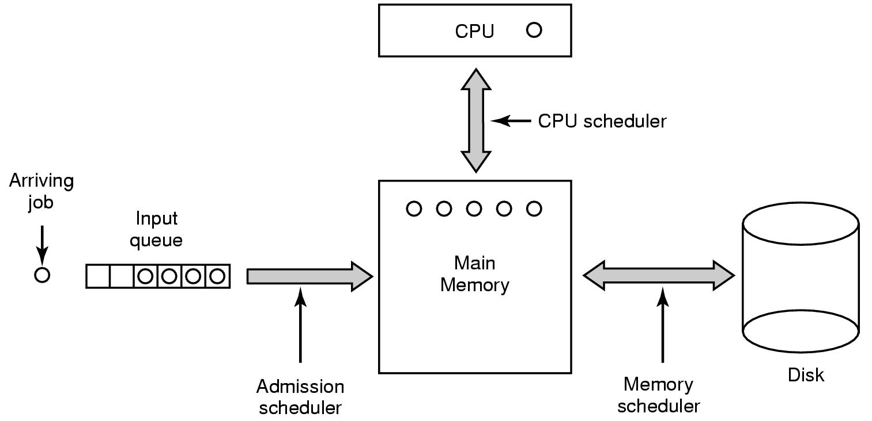
Scheduling in Batch Systems (2)
Three level scheduling

Slide 61
Scheduling in Interactive Systems
Round-robin scheduling
Priority scheduling
Multiple queues
Shortest process next
aging
Guaranteed scheduling
Fair-share scheduling
Lottery scheduling
Tanenbaum, Modern Operating Systems 3 e, (c) 2008 Prentice-Hall, Inc. All rights reserved. 0-13-6006639

Slide 62
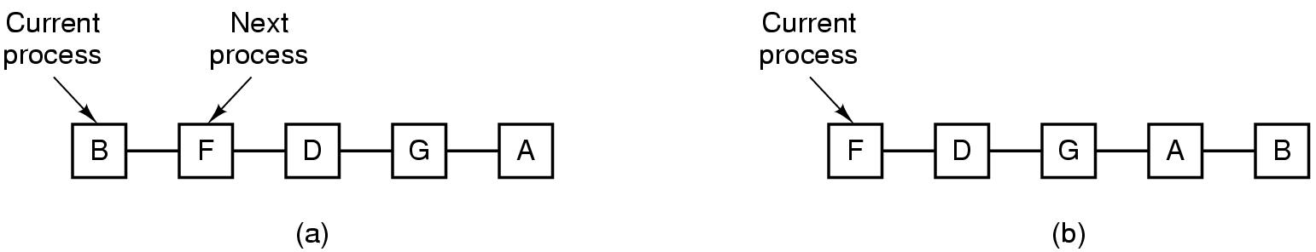
Scheduling in Interactive Systems (1)
Round Robin Scheduling
list of runnable processes
list of runnable processes after B uses up its quantum

Slide 63
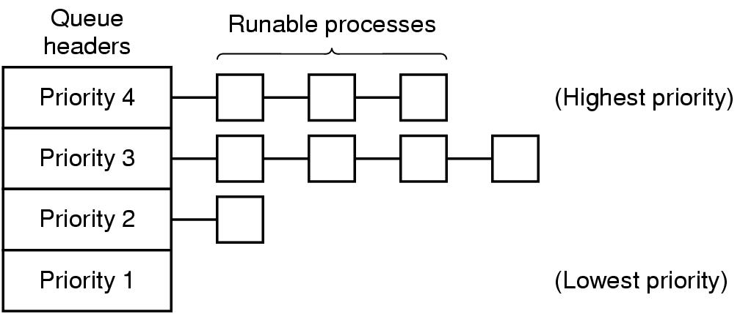
Scheduling in Interactive Systems (2)
100Q
Q= 1, 2, 4,8,16,32,64
A++
B++
X=Y
GETCH()
C.SW
C.SW
Q=1
Q=2
Q=4
Q=8
הפסקה 15 דקות
עד 19:54
A scheduling algorithm with four priority classes

Slide 64
Shortest process next
Agining
at0+ (1-a)t1

Slide 65
Shortest process next
Agining
at0+ (1-a)t1
צפי התחלתי 80
זמני ריצה שנמדדו בפועל (משאל לימין) 80,40,20,10
מה צפי זמן ריצה הבא?
A=1/2
0.5*80+0.5*80=80 ->60->40->25
65

Slide 66
Lottery
הגרלת כרטיסים,
המשתמש יכול לחלק כרטיסים בהסתברות שונה בין בניו/נכדיו או תהליכוניו
למשל חלוקת מניות ל
70,20,7,3
ההסתברות שהתהליך עם 70 מניות יעלה בגורל

Slide 67
Guaranteed scheduling
הבטחת חלוקת זמן זהה בין תהליכים

Slide 68
Fair share scheduling
חלוקת זמן הוגנת בין משתמשים

Slide 69
Scheduling in Real-Time Systems
Schedulable real-time system
Given
m periodic events
event i occurs within period P_{i} and requires C_{i} seconds
Then the load can only be handled if
20/100, 17/100 , 18/200,
מניחים החלפה זניחה
שאלות במבחן : כמה תהליכים של 17/100 ניתן להוסיף למערכת? תשובה 3

Slide 70
Policy versus Mechanism
Separate what is allowed to be done with how it is done
a process knows which of its children threads are important and need priority
Scheduling algorithm parameterized
mechanism in the kernel
Parameters filled in by user processes
policy set by user process

Slide 71
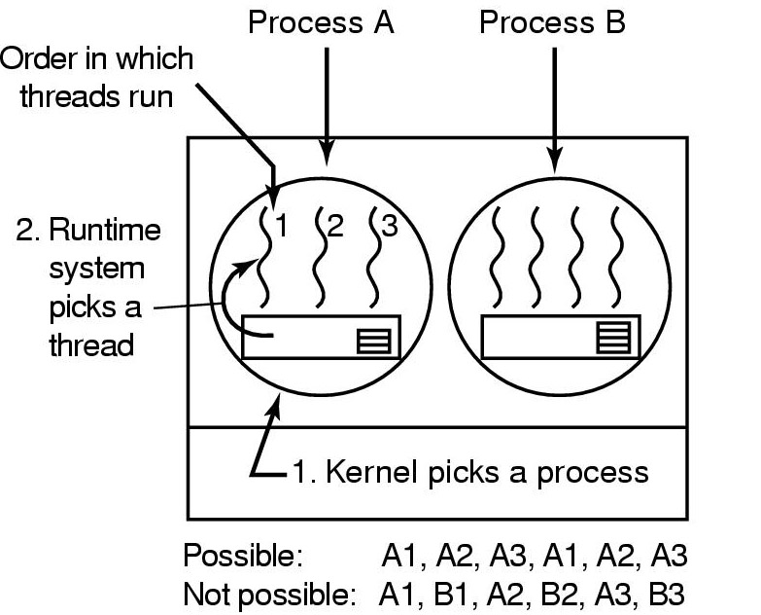
Thread Scheduling (1)
Possible scheduling of user-level threads
50-msec process quantum
threads run 5 msec/CPU burst

Slide 72
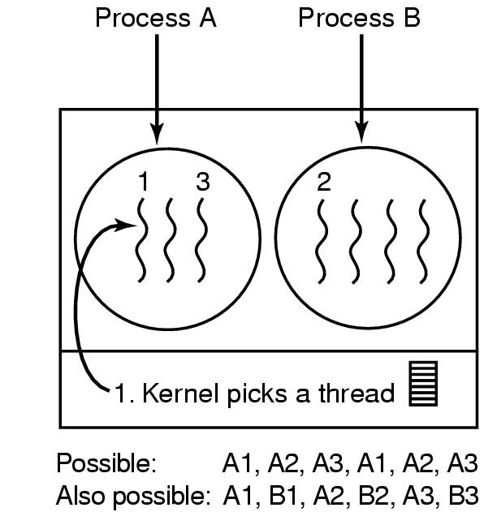
Thread Scheduling (2)
Possible scheduling of kernel-level threads
50-msec process quantum
threads run 5 msec/CPU burst

